Slide 1
Dermatology disease classification
Final project
Orymbekov Azamat

Slide 2
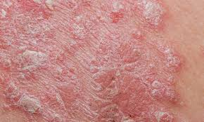
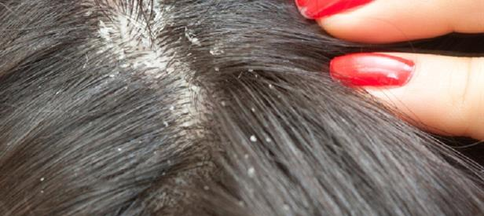
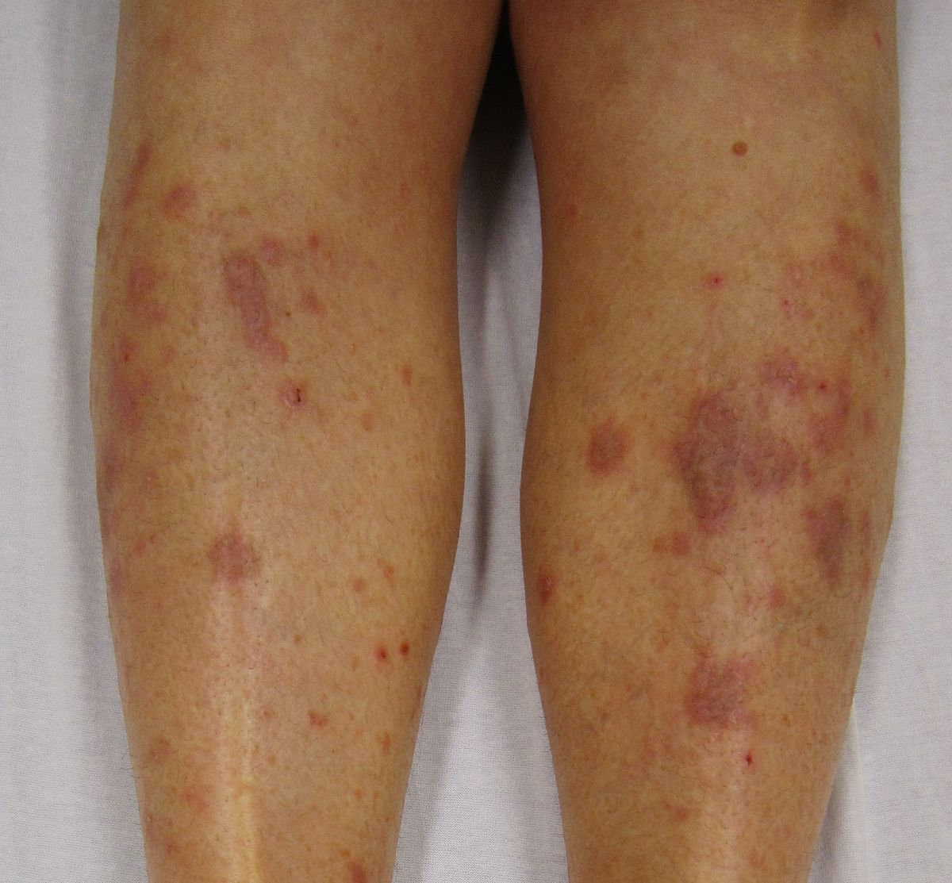
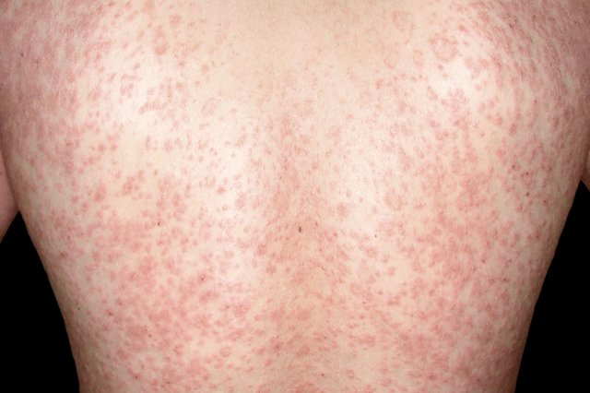
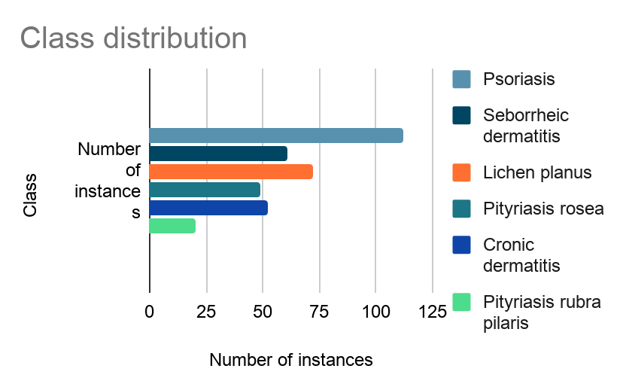
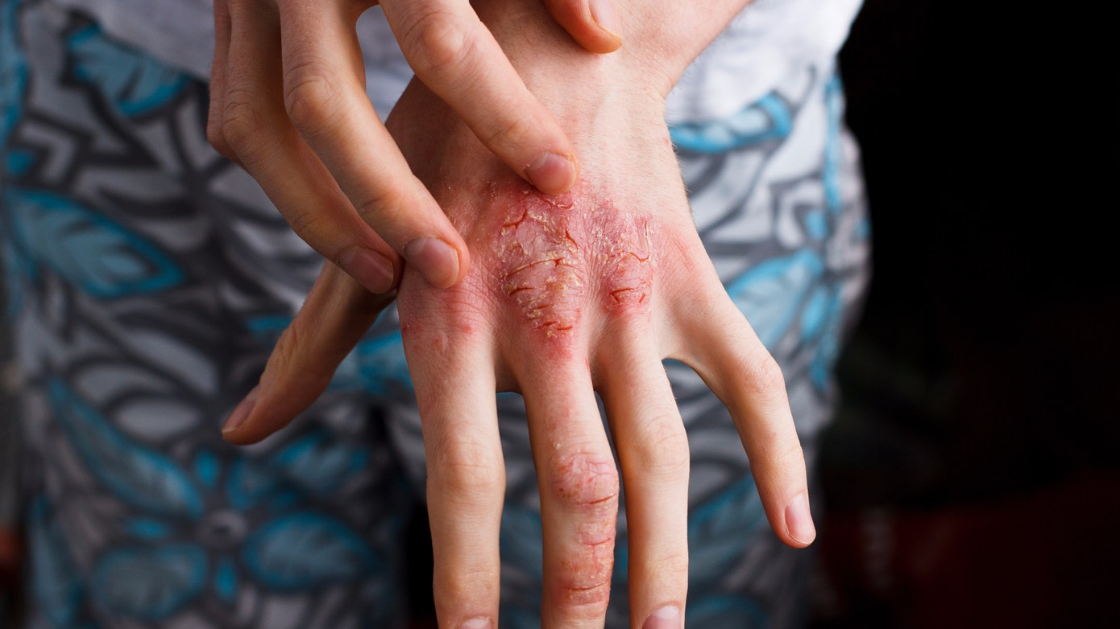
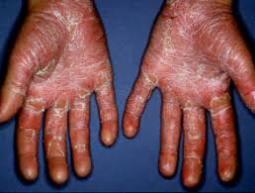
Цель проекта
Набор данных
Psoriasis
Seborrheic dermatitis
Lichen planus
Pityriasis rosea
Cronic dermatitis
Pityriasis rubra pilaris

Slide 3
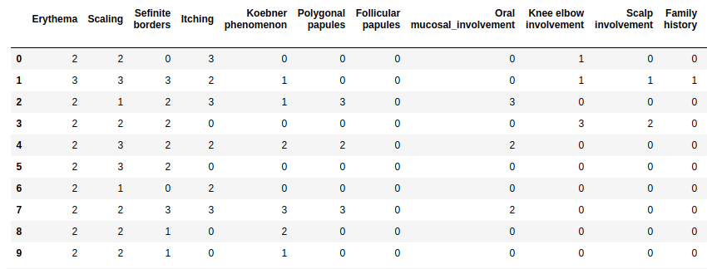

Slide 4
Explanatory visualizations

Slide 5
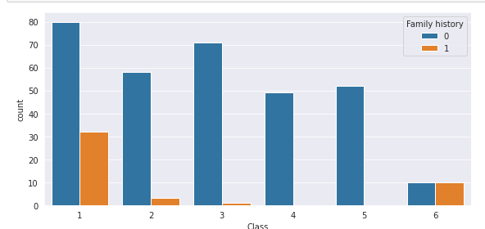

Slide 6
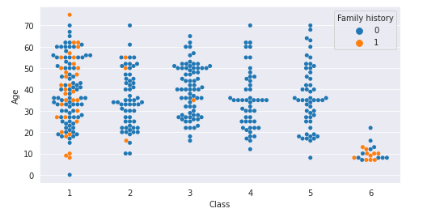

Slide 7
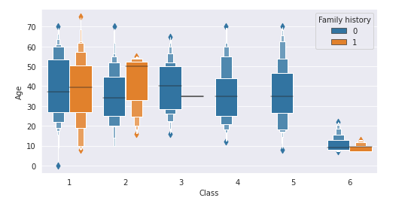

Slide 8
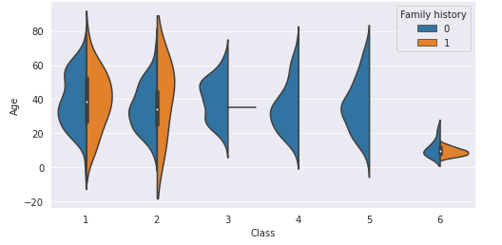

Slide 9
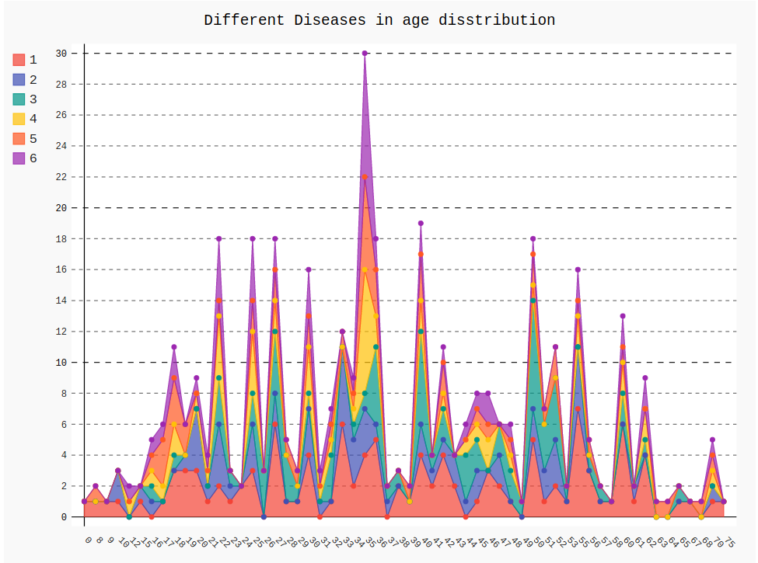

Slide 10
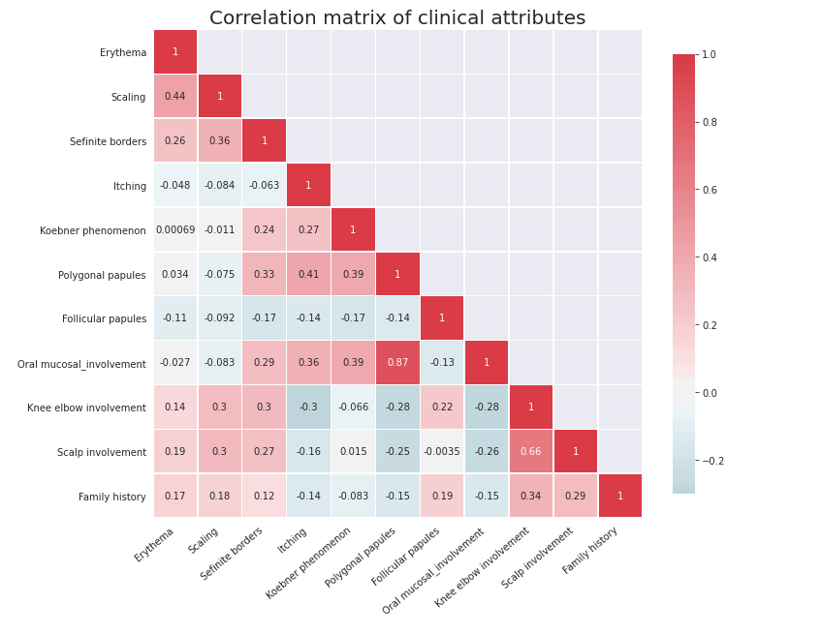

Slide 11
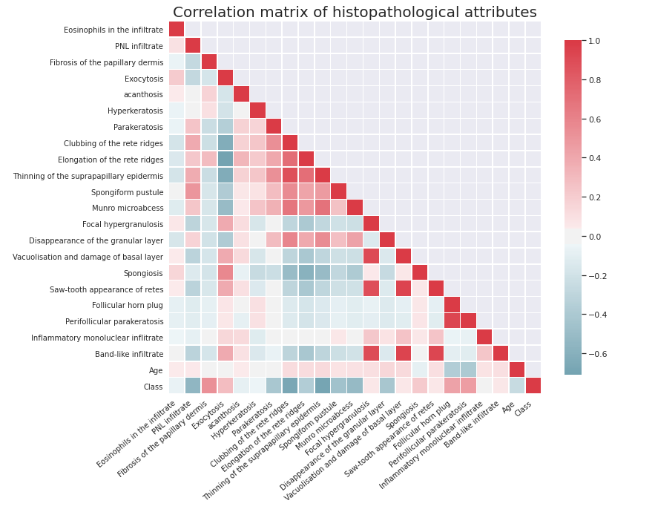

Slide 12
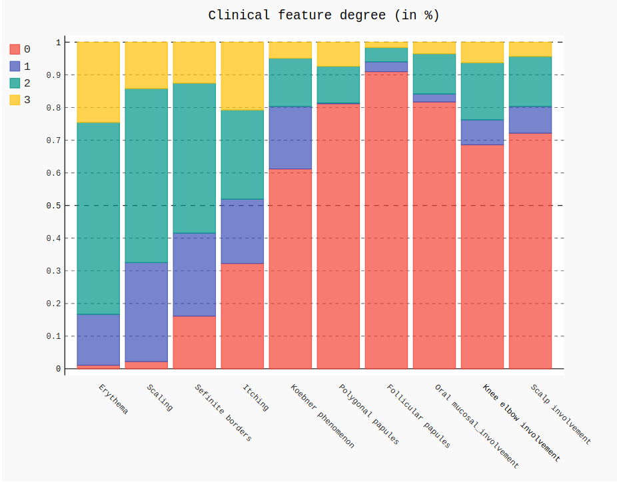

Slide 13
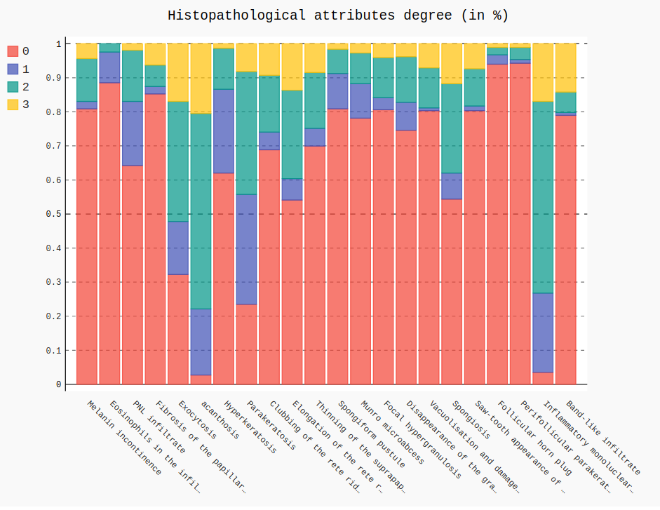

Slide 14
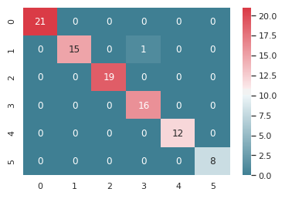
SVM results
Accuracy = 0.9891304347826086

Slide 15
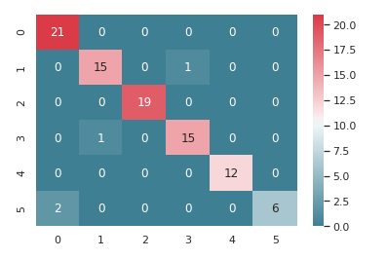
Random forest
Accuracy = 0.9565217391304348

Slide 16
Conclusion
Simply removing all rows which missing age, all the algorithm can achieve 100% accuracy. Also, the accuracy of this model depends on the amount of data which in total was involved in this experiment less than 300. After filling missing ages with mean, median and mode of the age column, only SVM can reach accuracy score of 98.65% with only miss classify one pityriasis rosea case as seborrheic dermatitis. SVM outperforms Random forest in this study, mainly because the dataset is linear, which make it easy to separate categories are divided by a clear gap. Accuracy can be improved further by accuracy ly imputing missing ages.

